Slide 1
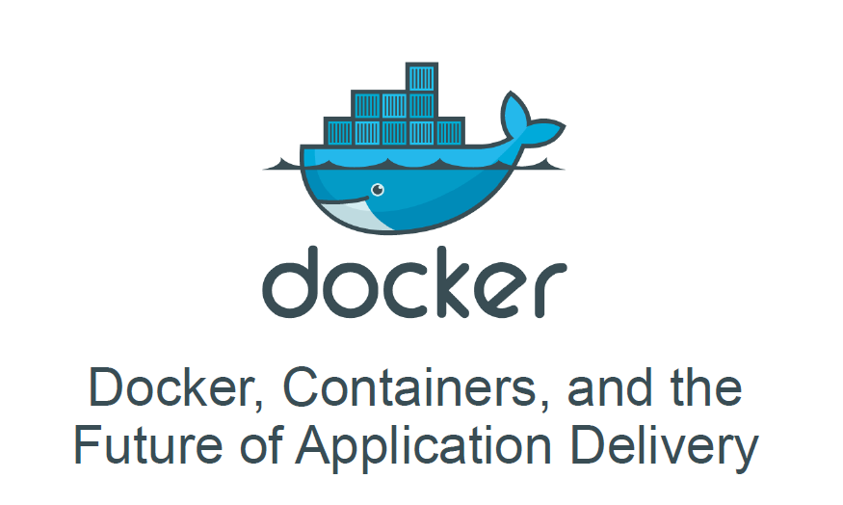
Introduction to Dockerisation

Slide 2
Contents
The Challenge
The Solution
Introduction to Containers
What is Docker ?
How is Docker better than VMs ?
Basics of Docker system?
Docker Images

Slide 3
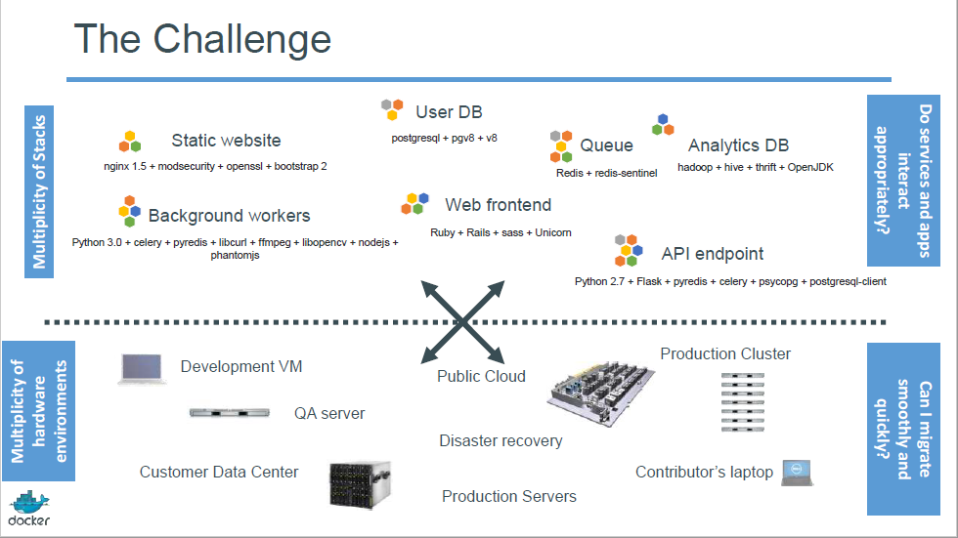

Slide 4
Contents
The Challenge
The Solution
Introduction to Containers
What is Docker ?
How is Docker better than VMs ?
Basics of Docker system?
Docker Images

Slide 5
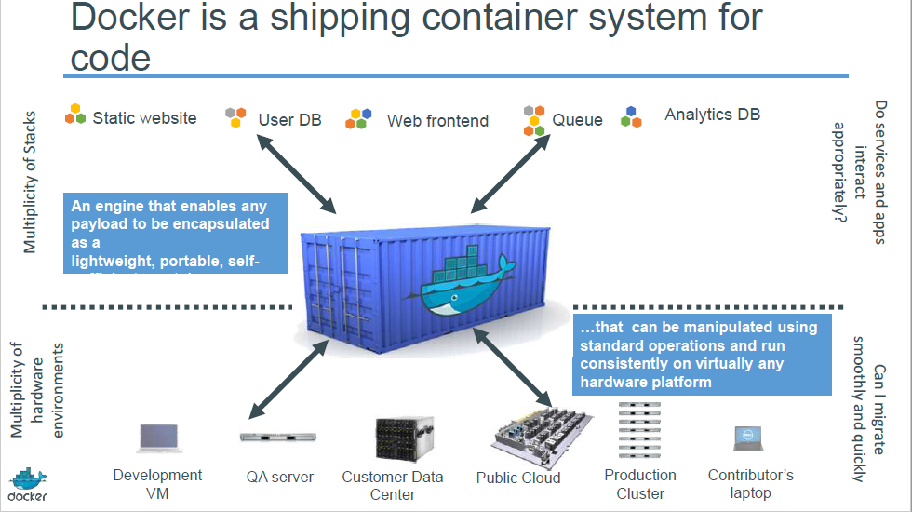

Slide 6
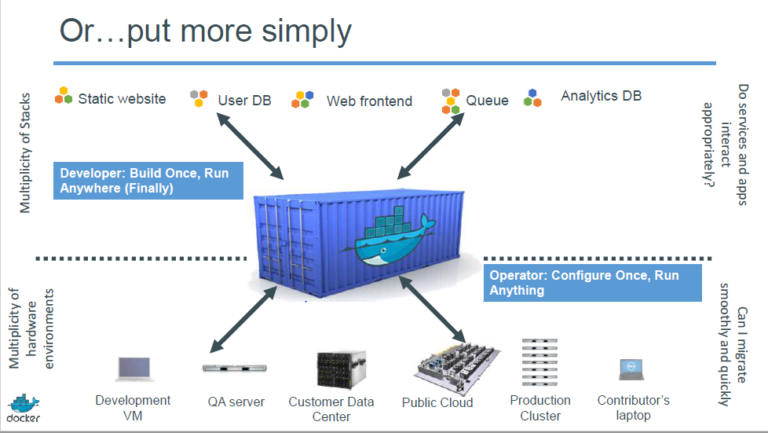

Slide 7
Contents
The Challenge
The Solution
Introduction to Containers
What is Docker ?
How is Docker better than VMs ?
Basics of Docker system?
Docker Images

Slide 8
Containers
LXCs (Linux Containers) are operating system level virtualization method for running multiple isolated linux systems (Containers) on the host using single linux kernel.
LXCs are lightweight alternative to VMs.
Dockers are also based on the concept of LXCs.

Slide 9
Contents
The Challenge
The Solution
Introduction to Containers
What is Docker ?
How is Docker better than VMs ?
Basics of Docker system?

Slide 10
What is Docker ?
Docker is a open-source containerization platform that automates the deployment of applications inside the software container.
A container image is standalone executable package of piece of software that includes everything needed to run it-
Real OS
Software that is to be deployed
Dependencies to run the project
Environment variables

Slide 11
Contents
The Challenge
The Solution
Introduction to Containers
What is Docker ?
How is Docker better than VMs ?
Basics of Docker system?
Docker Images

Slide 12
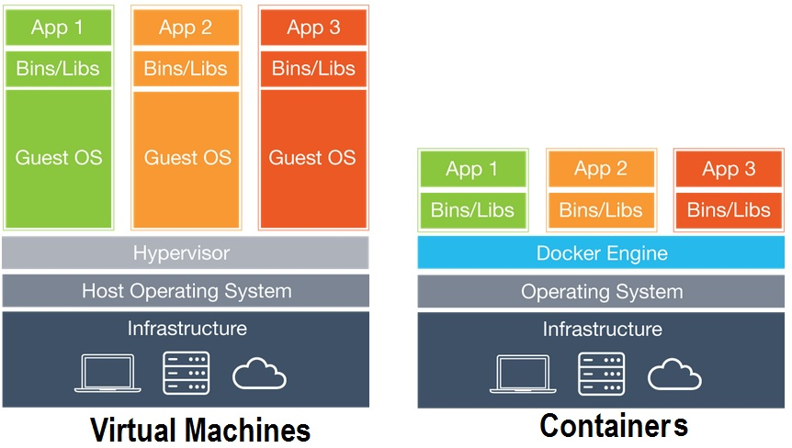
Container vs. VMs
Containers are isolated, but share OS and, where appropriate, bins and libraries

Slide 13
Container vs. VMs
VMs divide a computer system into completely different systems(isolated), just like two OS in one PC.
Dockers are containers with all dependencies but they share the kernel with other containers.

Slide 14
Some more points about Dockers
All the containers reside on-
https://hub.docker.com/explore/
which is a public repository
Docker Cloud
Which is a private repository
Dockers also provide versioning properties similar to GitHub, new versions can be transferred by sending only differences.
Apart from CUI it also provides GUI .

Slide 15
Contents
The Challenge
The Solution
Introduction to Containers
What is Docker ?
How is Docker better than VMs ?
Basics of Docker system?
Docker Images

Slide 16
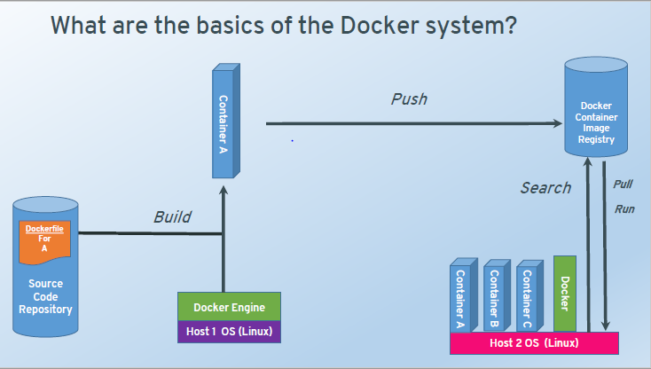
Basic Architecture

Slide 17
Contents
The Challenge
The Solution
Introduction to Containers
What is Docker ?
How is Docker better than VMs ?
Basics of Docker system?
Docker Images

Slide 18
Docker Images
A Docker image is an inert, immutable, read-only snapshot of a container
Analogy-
Image is a recipe and Container is cake
Images are built by build command, they produce container when run.
Images are composed of layers, starting with a base image and then all layers above it.
If a Image is a class, then container is a instance (a runtime object).

Slide 19
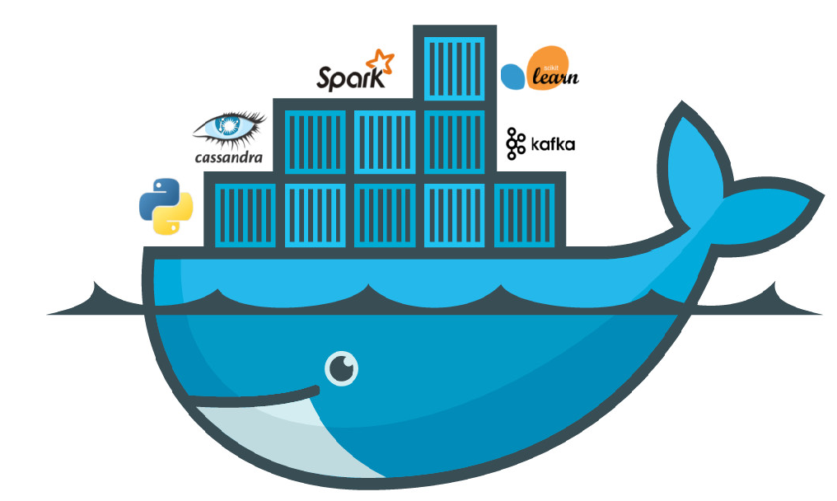
Getting started with Docker

Slide 20
Environment Setup
Download and install docker from-
https://www.docker.com
Test Docker version
Run docker –version to know your current version
docker info gives complete information about docker.
docker help or simply docker gives information about all docker commands
Test installation
Test by running a Docker image, Hello-world
docker run hello-world

Slide 21
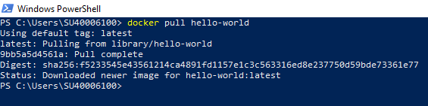
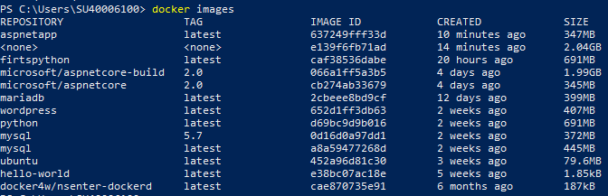
Pulling Hello-World
After the pulling is done, we can see the pulled images by- docker images – command.

Slide 22
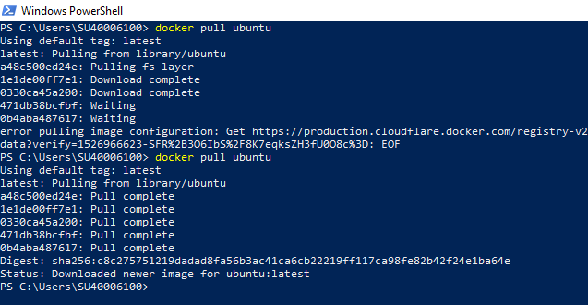
Running Ubuntu in Windows
For this we need to pull image of Ubuntu form hub.docker.com

Slide 23

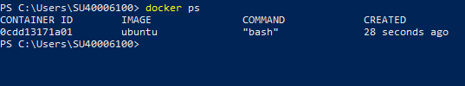
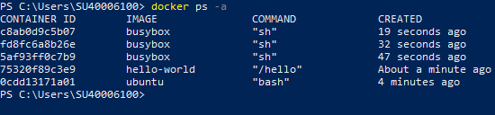
Running Ubuntu
Now you can run all Ubuntu commands, Mkdir etc,
Everything will be dine inside the container.
The –it command runs Ubuntu in an interactive mode.
You can see all running containers through docker ps command
Docker ps –a shows all containers (running and stopped)

Slide 24
Some useful commands
docker rm
Removes containers, only stopped containers can be removed.
docker stop
Stops running containers
docker rmi
Removes images
docker logs “ container id”
Shows logs of conatiners

Slide 25
Part :2
Dockerisation of Python Application
Introduction to Docker file
Creating Docker file
Building Image
Creating a container from Image

Slide 26
Introduction to Docker File
A Dockerfile is a document with no extension that contains all commands required to assemble image.
Docker can build images by reading the instructions from dockerfile.
Docker build command is used to build image from dockerfile
Dockerfile has a fixed syntax, we can use commands like From, Run , Cmd, Copy etc.

Slide 27
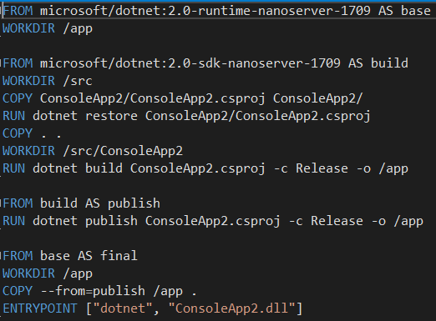
Sample Dockerfile

Slide 28
From : specifies the base image from which your building
Workdir: The WORKDIR directive is used to set where the command defined with CMD is to be executed.
Add: takes 2 arguments, copies the files from source to destination
Cmd: used for executing a specific command but command is executed only when container is run not when image is built.

Slide 29
Entrypoint: sets up the default application that is used every time a container is made using that image.
Env: used to set up env variables, consists of key-value pairs which can be accessed by applications inside the container
Expose: used to associate a specified port to enable networking between running process inside the container and outside world.
Run: it takes a command as it is argument, runs it to form image . Used to build the image unlike CMD.

Slide 30
Part :2
Dockerisation of Python Application
Introduction to Docker file
Creating Docker file
Building Image
Creating a container from Image

Slide 31
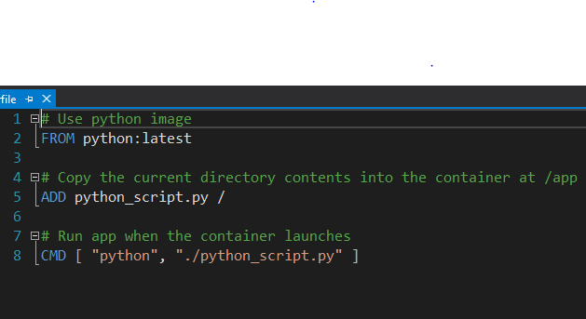
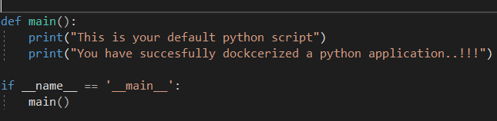
Creating the DockerFile
The Python Application (python_script.py)

Slide 32
Part :2
Dockerisation of Python Application
Introduction to Docker file
Creating Docker file
Building Image
Creating a container from Image

Slide 33
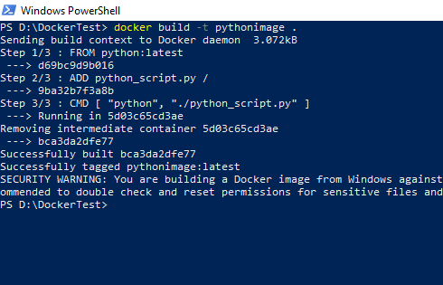

Building the Python Image
Checking the newly created Image

Slide 34
Part :2
Dockerisation of Python Application
Introduction to Docker file
Creating Docker file
Building Image
Creating a container from Image

Slide 35
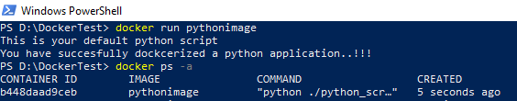
Running the image formed
The container in which python application was running can be seen by docker ps –a command.
Image can also be run using its image ID.
Docker run “ Image_Id”

Slide 36
Part :3
Dockerisation ofAsp.NET Application
Create the Asp.NET application
Enable Docker Support
Perform Docker-compose
Run the Container via Docker-compose run

Slide 37
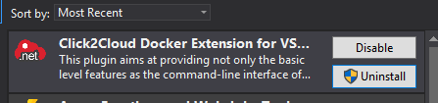
Some settings for dockerisation of .NET applications
In Docker for Windows icon in Task bar right click and then select the option Switch to windows Containers (should be linux containers for ubuntu)
Install visual Studio 2017 and add extension Click2Cloud from tools menu .
Note: This extension is optional .

Slide 38
Creating an Asp.NET application
You can create an Asp.NET application in visual studio.
Click create new project then select visual C# option from side pane and then select ASP.NET core web application.
After creating click on Project menu at the top and then select Docker Support option .

Slide 39
Part :3
Dockerisation ofAsp.NET Application
Create the Asp.NET application
Enable Docker Support
Perform Docker-compose
Run the Container via Docker-compose run

Slide 40
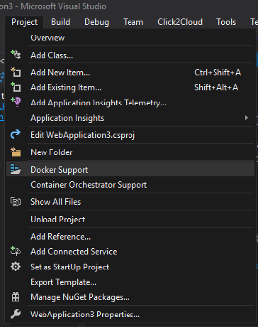
It prompts you to select target OS, select windows .
It can automatically switch to windows from linux containers.
Docker Files have been built (docker-compose, dockerfile).
Go to Powershell window and move to directory where docker-compose file is kept and type the command docker-compose up .

Slide 41
Part :3
Dockerisation ofAsp.NET Application
Create the Asp.NET application
Enable Docker Support
Perform Docker-compose
Run the Container via Docker-compose run

Slide 42
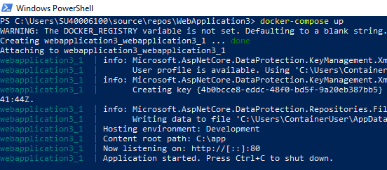
Image building will start and after some time app will start automatically.
To view the application in browser open a new powershell window and type docker-compose ps commands to know the port in which container is running.
Now go to browser and type- Localhost:port_no , Application starts .

Slide 43
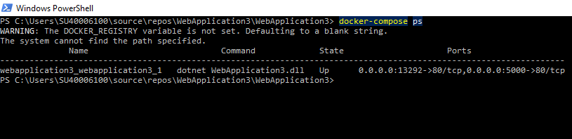
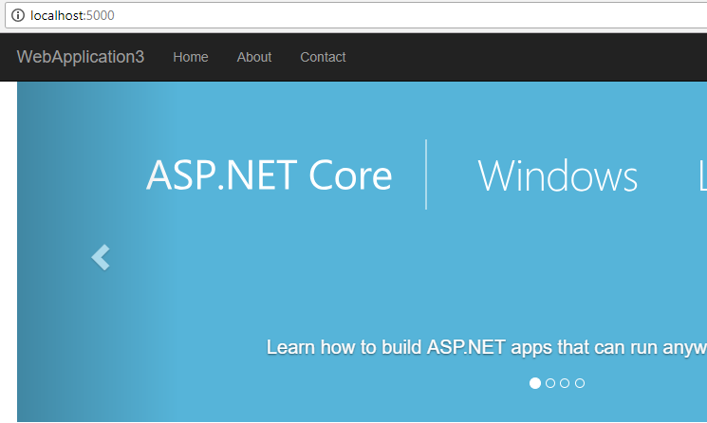

Slide 44
Part :3
Dockerisation ofAsp.NET Application
Create the Asp.NET application
Enable Docker Support
Perform Docker-compose
Run the Container via Docker-compose run

Slide 45
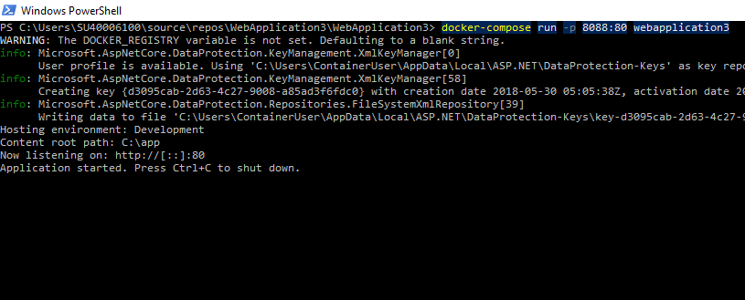
To check running docker-compose containers- docker-compose ps
To stop containers- docker-compose stop
To remove stopped containers– docker-compose rm

Slide 46
Some Common Problems Faced
Remote host forcibly closed connection-
Arises due to proxy issue, check once and then restart docker.
No such manifest available for windows or linux
You need to switch your docker container type to other one.
EOF error
Restart Docker

Slide 47
References
https://docs.docker.com/
It has complete documentation for dockers
https://docs.microsoft.com/en-us/
For dockerisation of Asp.NET application
My Notes for complete Reference

Slide 48
Thank you

